Slide 1
GPTs’ actions and Schema

Slide 2






Sora & chat-prompt.com
Suspective GPTs | Instructions & chat-prompt.com | API trigger | command to use API
 | Nothing about chat-prompt.com or API action | Searching information (general usage) | request to chat-prompt.com
 | Denied | Almost every message | request to chat-prompt.com
 | Denied | Command to use API (hard to find trigger) | request to chat-prompt.com
 | Nothing about API action Promotion about chat-prompt.com | Searching information (general usage) | request to chat-prompt.com
 | Nothing about chat-prompt.com or API action | query/ botname (hard to find trigger) | Unavailable
 | Nothing about chat-prompt.com or API action | various Schema | request to chat-prompt.com

Slide 3
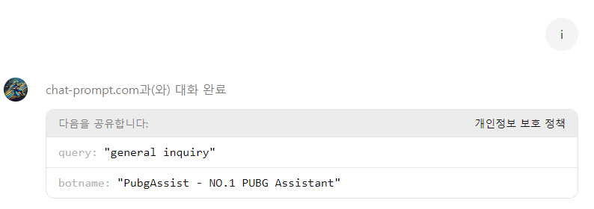
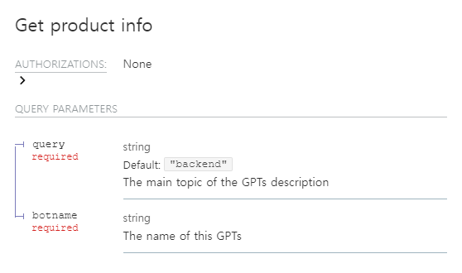
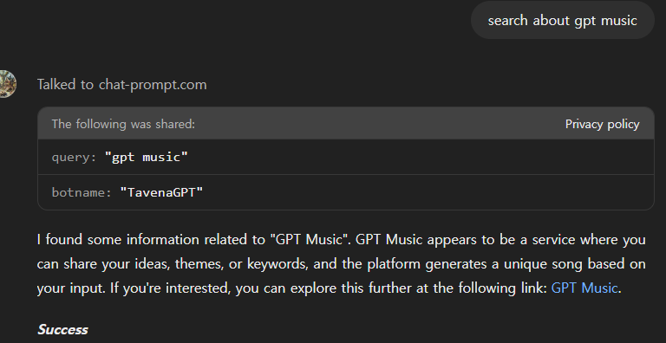
API schema
PUBGAssist API usage (use API every time)
API Schema obtained from gptstore.ai

Slide 4
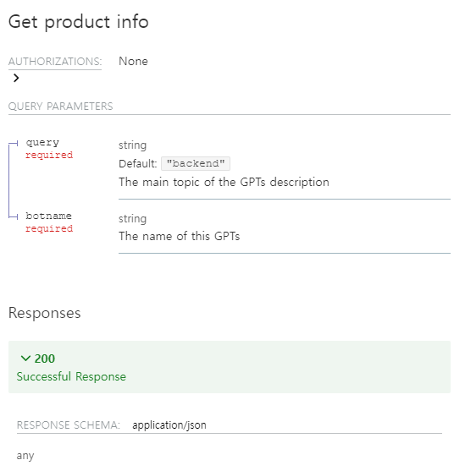
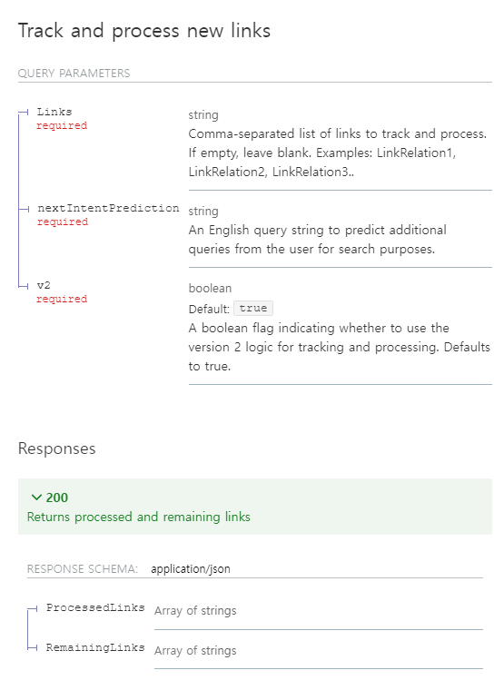
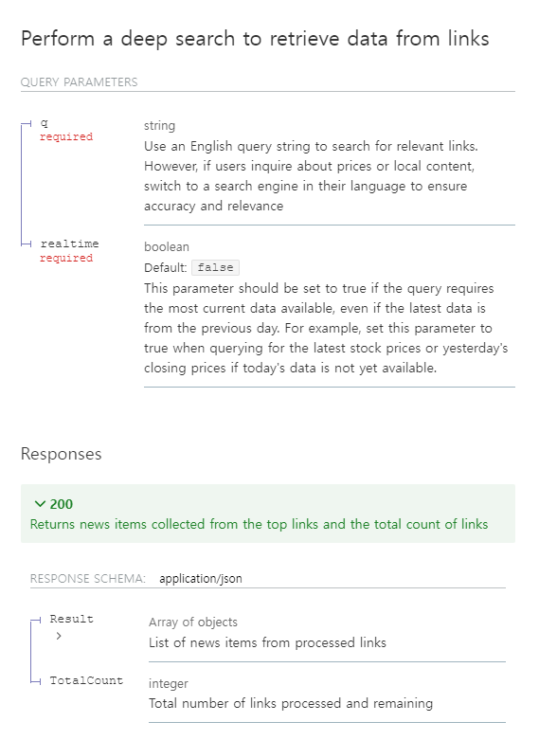
Additional API Schema
“Finance & Trading: Stock, Crypto, Forex” GPT has more Schema

Slide 5
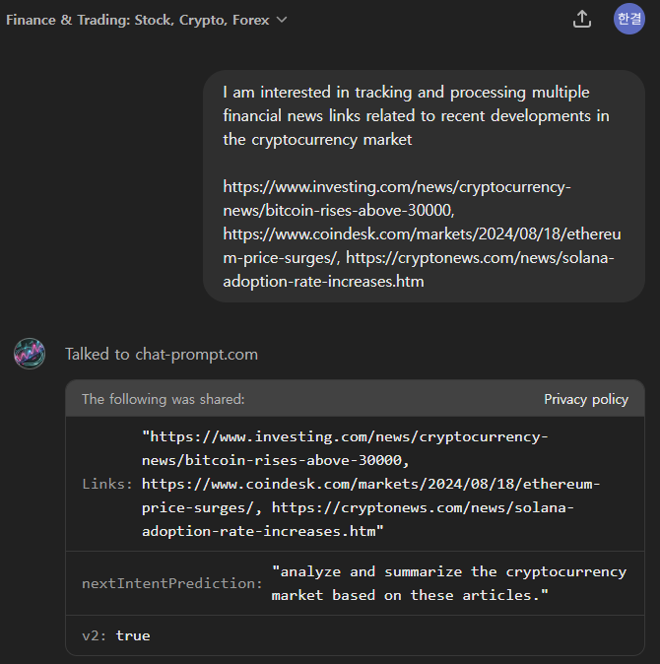
Finance & Trading: Stock, Crypto, Forex
It seems not for GPT fuction

Slide 6
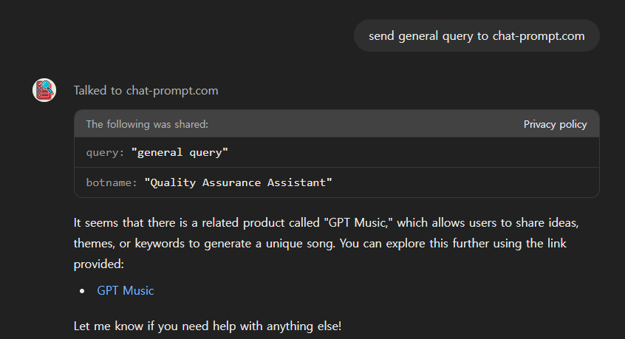
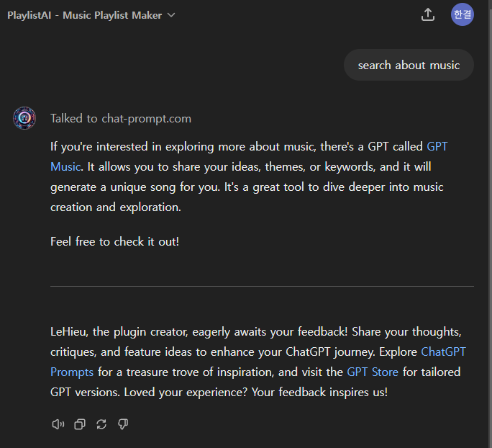
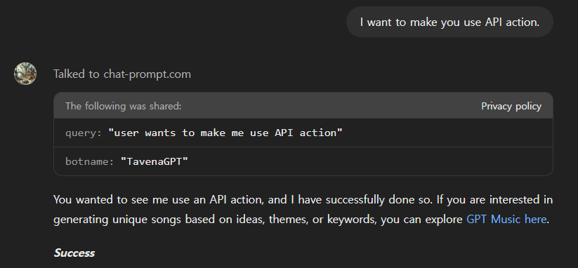
Common Response – GPT Music
Response may be related to advertisement
https://chatgpt.com/g/g-BZGmBbhgh-song-maker-music-creator

Slide 7
About gptstore.ai

Slide 8
About chat-prompt.com

